Slide 1
Single-variate Linear Regression with Bias Term
Deep-Learning Seminar ch.7

Slide 2
Contents
Single-variate Linear Regression
Loss Function
Gradient Descent
Learning Rate

Slide 3
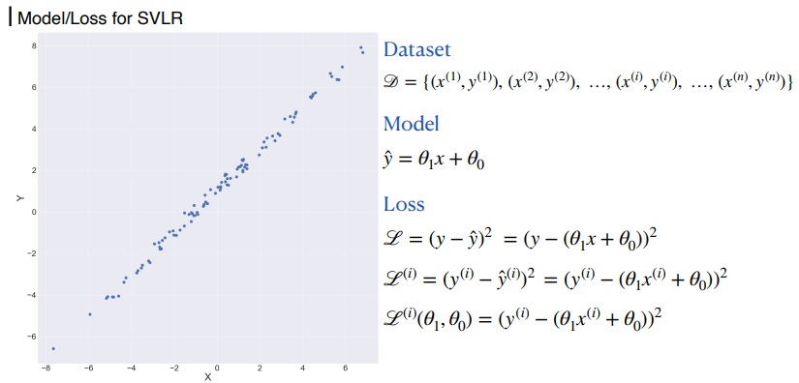
1. Single-variate Linear Regression

Slide 4
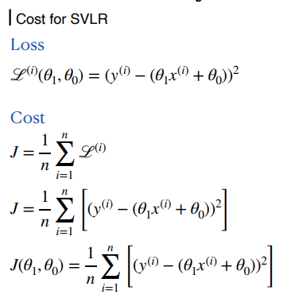
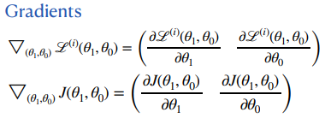
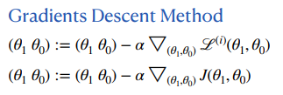
1. Single-variate Linear Regression

Slide 5
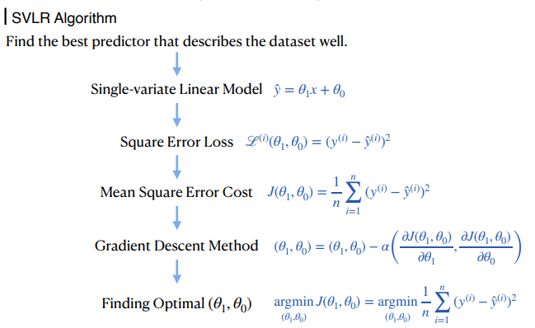
1. Single-variate Linear Regression

Slide 6
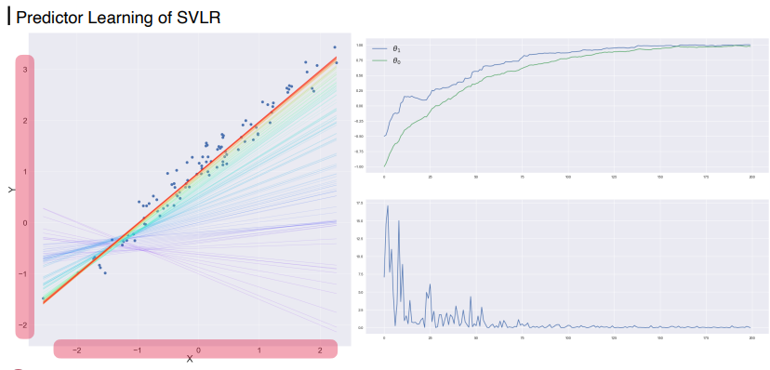
1. Single-variate Linear Regression

Slide 7
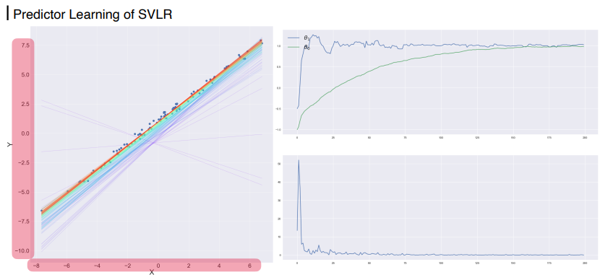
1. Single-variate Linear Regression

Slide 8
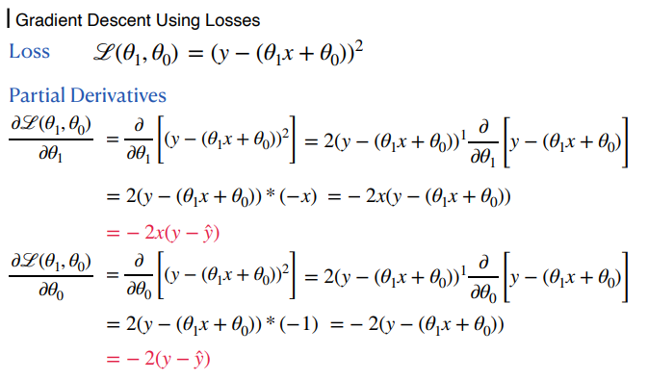
1. Single-variate Linear Regression

Slide 9
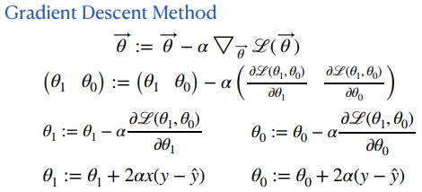
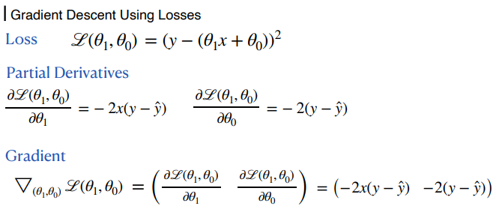
1. Single-variate Linear Regression

Slide 10
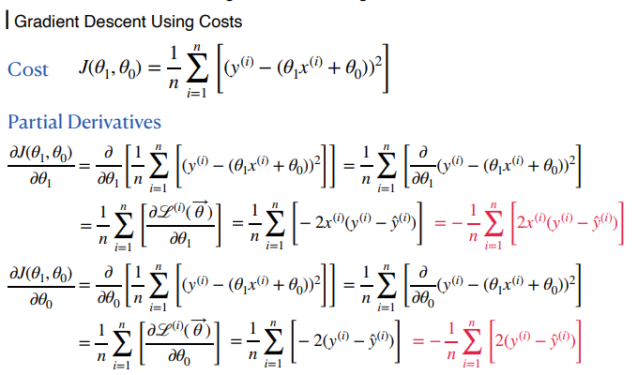
1. Single-variate Linear Regression

Slide 11
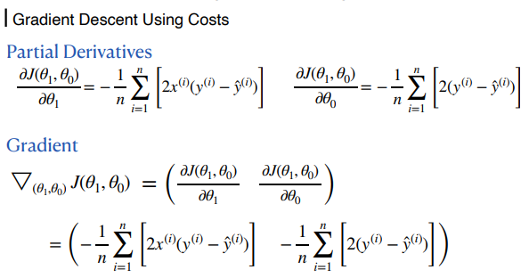
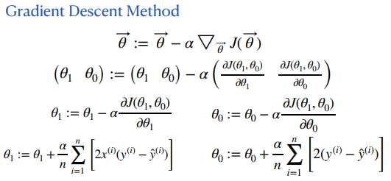
1. Single-variate Linear Regression

Slide 12
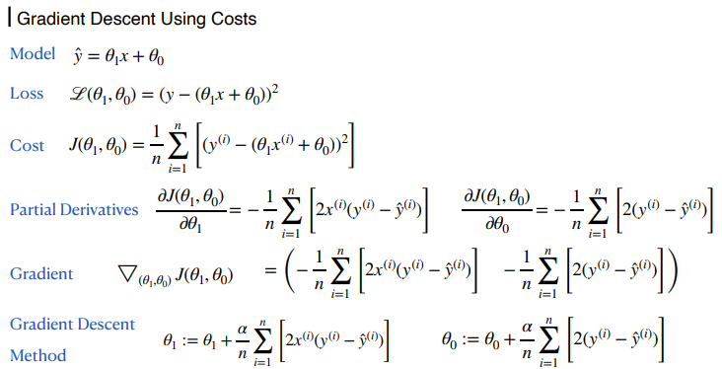
1. Single-variate Linear Regression

Slide 13
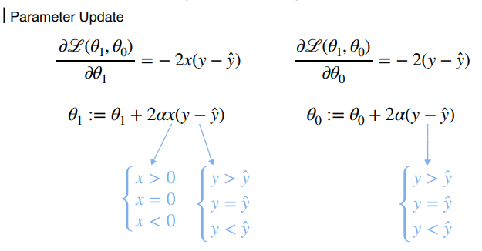
1. Single-variate Linear Regression

Slide 14
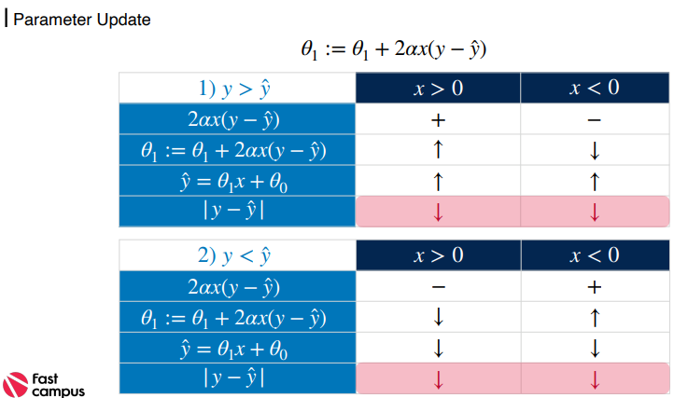
1. Single-variate Linear Regression

Slide 15
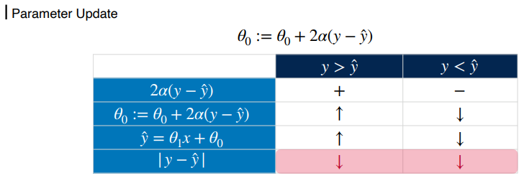
1. Single-variate Linear Regression

Slide 16
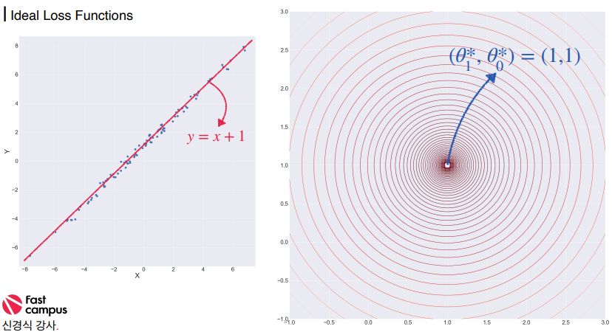
2. Loss Function

Slide 17
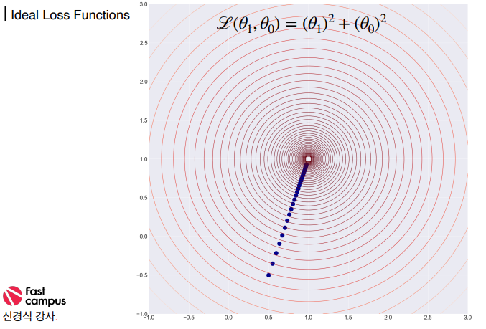
2. Loss Function

Slide 18
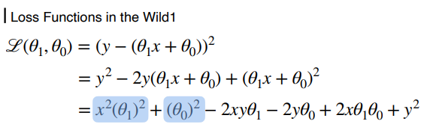
2. Loss Function

Slide 19
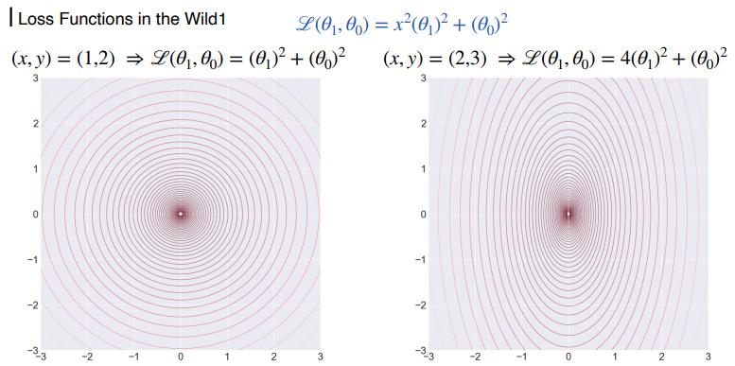
2. Loss Function

Slide 20
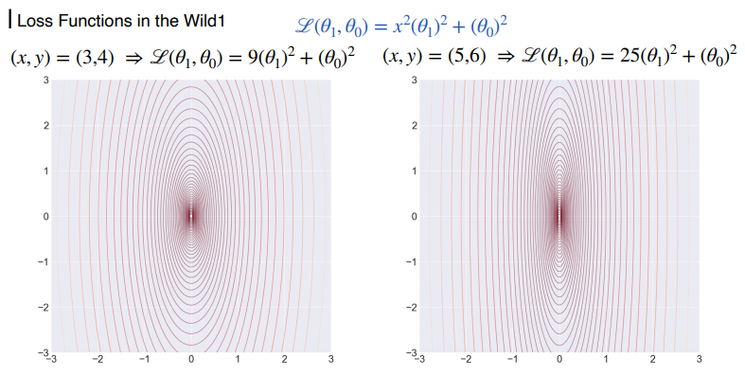
2. Loss Function

Slide 21
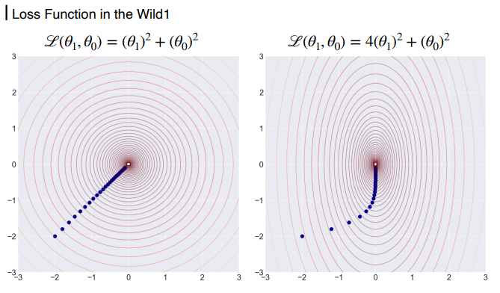
2. Loss Function

Slide 22
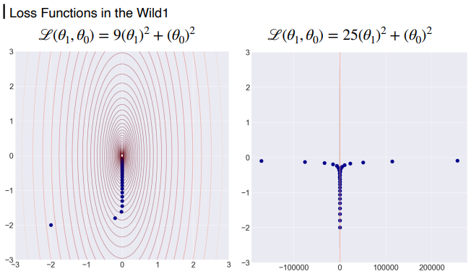
2. Loss Function

Slide 23
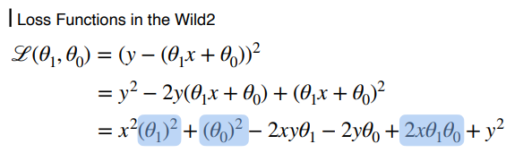
2. Loss Function

Slide 24
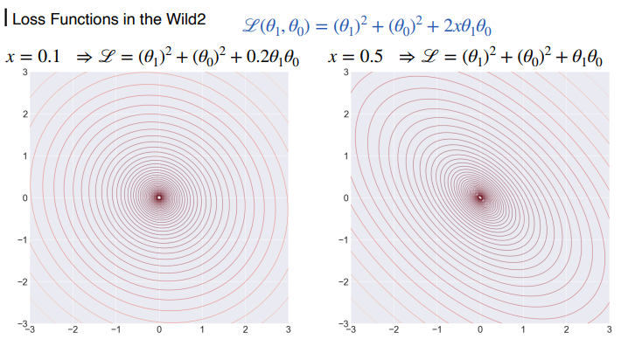
2. Loss Function

Slide 25
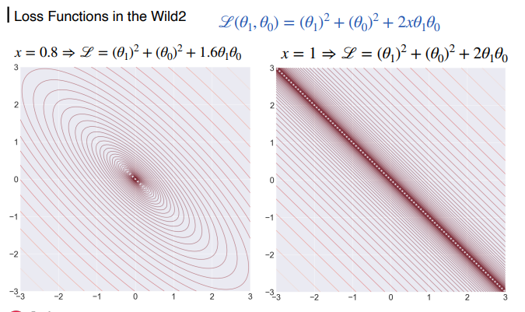
2. Loss Function

Slide 26
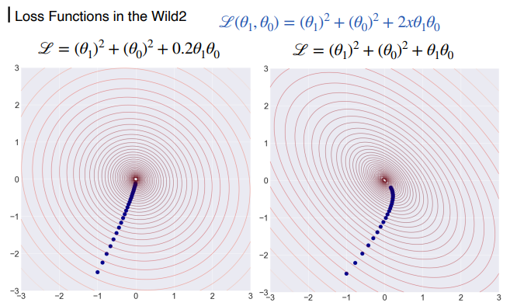
2. Loss Function

Slide 27
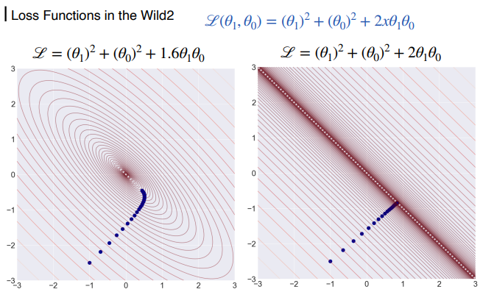
2. Loss Function

Slide 28
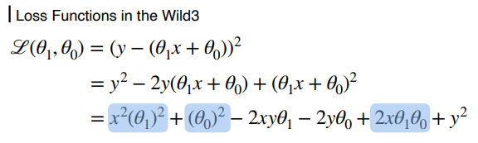
2. Loss Function

Slide 29
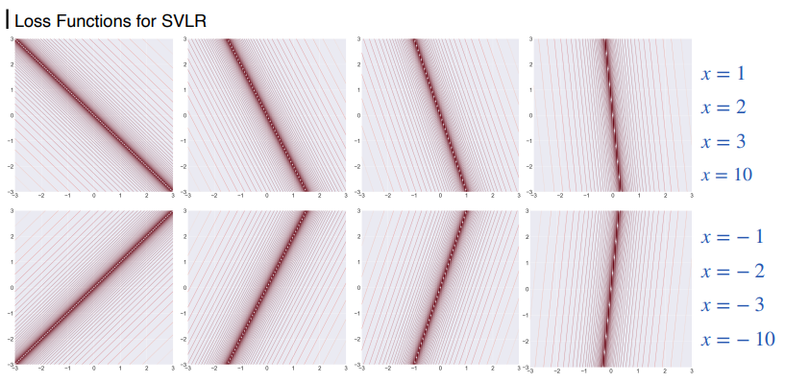
2. Loss Function

Slide 30
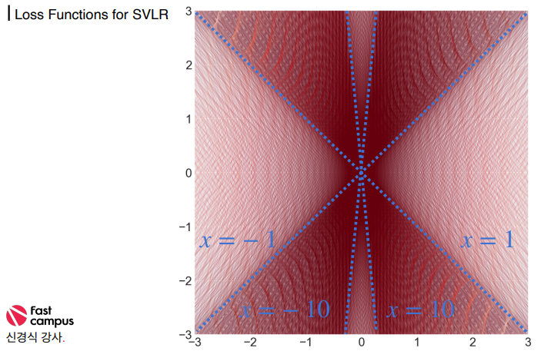
2. Loss Function

Slide 31
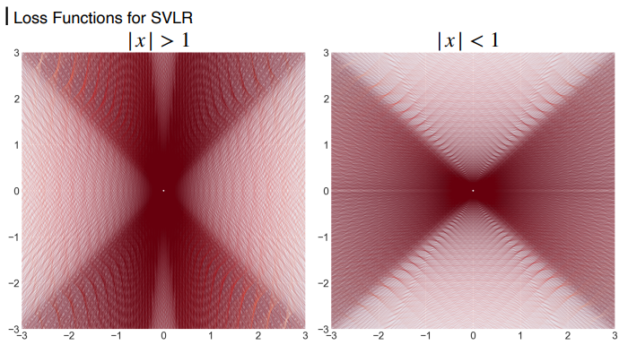
2. Loss Function

Slide 32
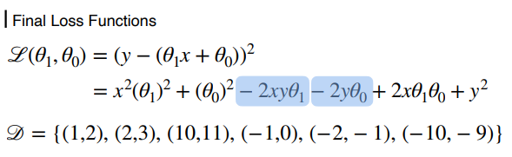
2. Loss Function

Slide 33
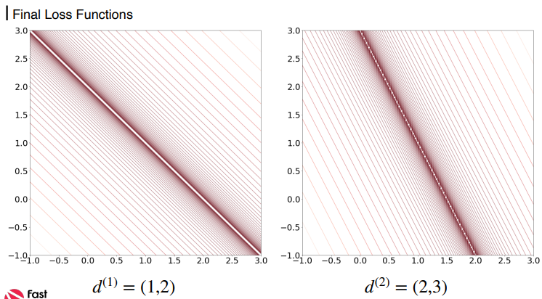
2. Loss Function

Slide 34
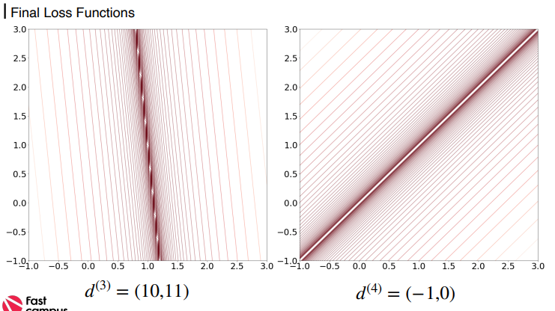
2. Loss Function

Slide 35
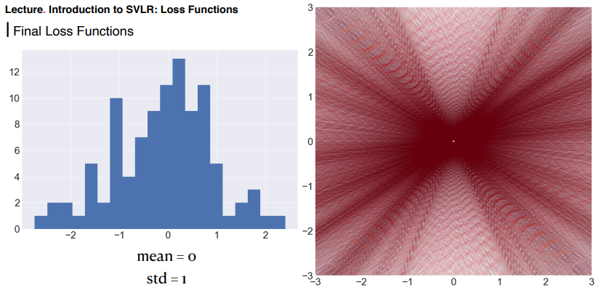
2. Loss Function

Slide 36
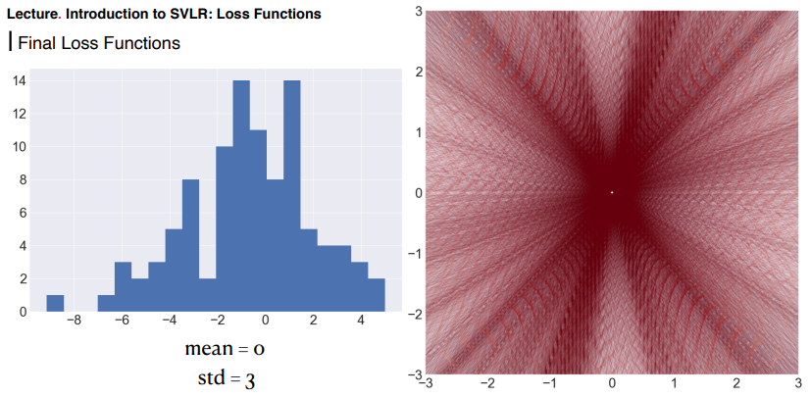
2. Loss Function

Slide 37
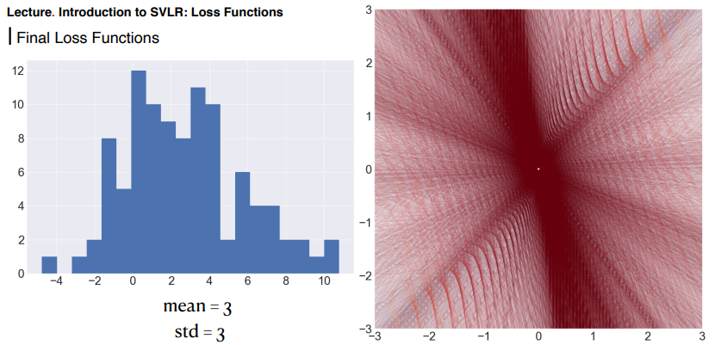
2. Loss Function

Slide 38
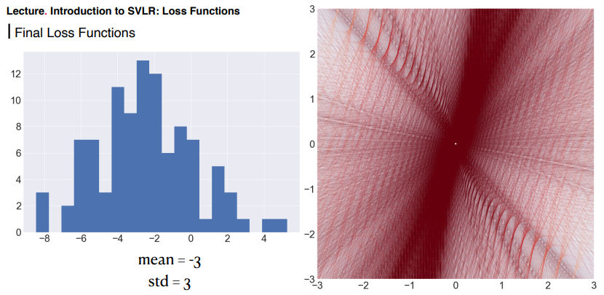
2. Loss Function

Slide 39
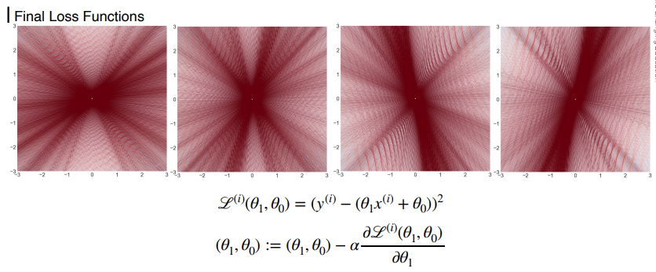
2. Loss Function

Slide 40
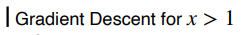
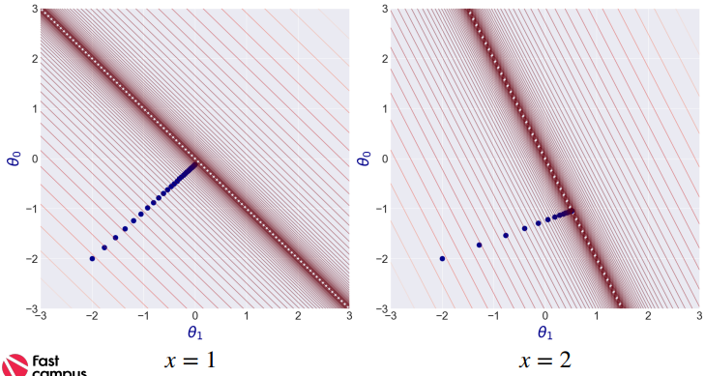
3. Gradient Descent

Slide 41
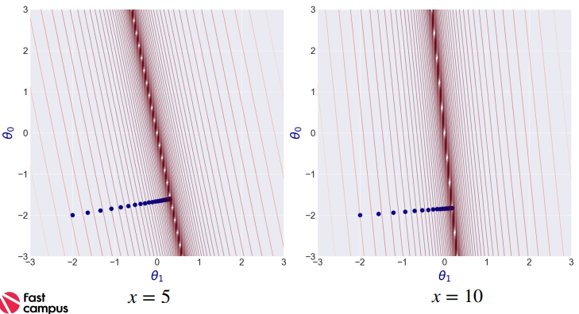
3. Gradient Descent

Slide 42
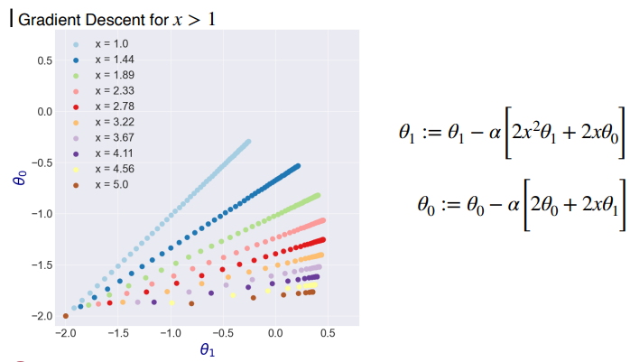
3. Gradient Descent

Slide 43
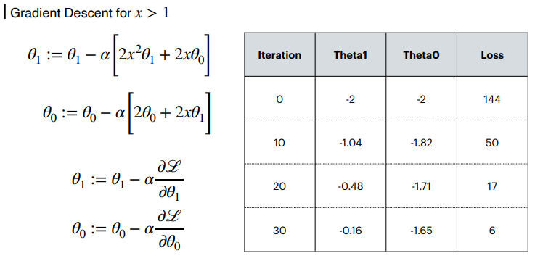
3. Gradient Descent

Slide 44
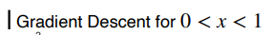
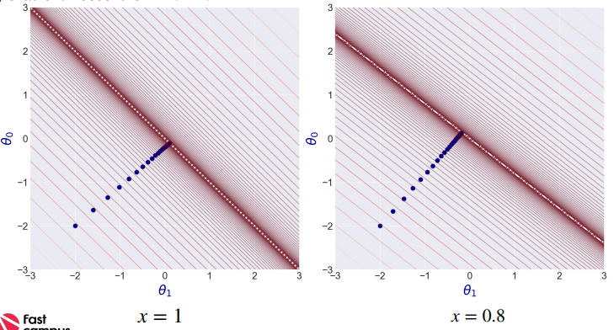
3. Gradient Descent

Slide 45
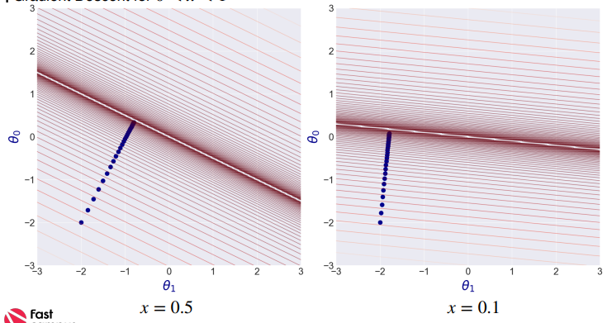
3. Gradient Descent

Slide 46
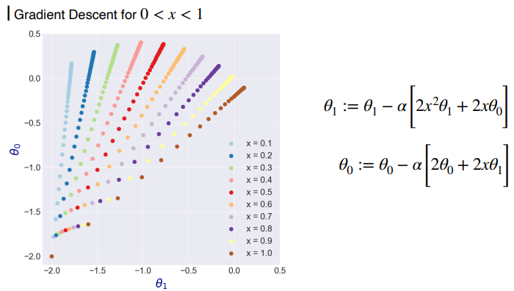
3. Gradient Descent

Slide 47

3. Gradient Descent

Slide 48

3. Gradient Descent

Slide 49

3. Gradient Descent

Slide 50

3. Gradient Descent

Slide 51

3. Gradient Descent

Slide 52

3. Gradient Descent

Slide 53

3. Gradient Descent

Slide 54

3. Gradient Descent

Slide 55

3. Gradient Descent

Slide 56

4. Learning Rate

Slide 57

4. Learning Rate

Slide 58

4. Learning Rate

Slide 59

4. Learning Rate

Slide 60

4. Learning Rate

Slide 61

4. Learning Rate

Slide 62

4. Learning Rate

Slide 63

4. Learning Rate

Slide 64

4. Learning Rate

Slide 65

4. Learning Rate

Slide 66
감사합니다.

